Slide 1
Welcome to Alvin FFA
Orientation

Slide 2
Introductions

Slide 3
The Alvin FFA Alumni

Slide 4
Opportunities in FFA
Leadership Development Events
Career Development Events
Speaking Development Events
Community Service Opportunities
Monthly FFA Meetings
FFA Activity Committee’s
Livestock Show Participation
Leadership Conferences
Team Building
Info. to be inserted...LDES

Slide 5
LDE’s
Webb
FFA Broadcasting
Job Interview
Creed (Junior and Senior)
Jennings
Chapter Conducting
Skills Demonstration
Mayo
Skills Demonstration
Clark
Quiz (Junior and Senior)
Worrel
Agricultural Issues

Slide 6
CDE’s
Floral- Mrs. Webb
Livestock
Entomology- Mrs. Clark
Food Science
Land Evaluation- Mrs. Jennings
Homesite
Ag Clays Shooting Sports- Mrs. Jennings
Wildlife - Mr. Mayo
Horse Evaluation- Mrs. Clark
Veterinary Science- Mrs. Clark
Meat Evaluation- Mrs. Worrel
Milk Quality
Poultry
Wool

Slide 7
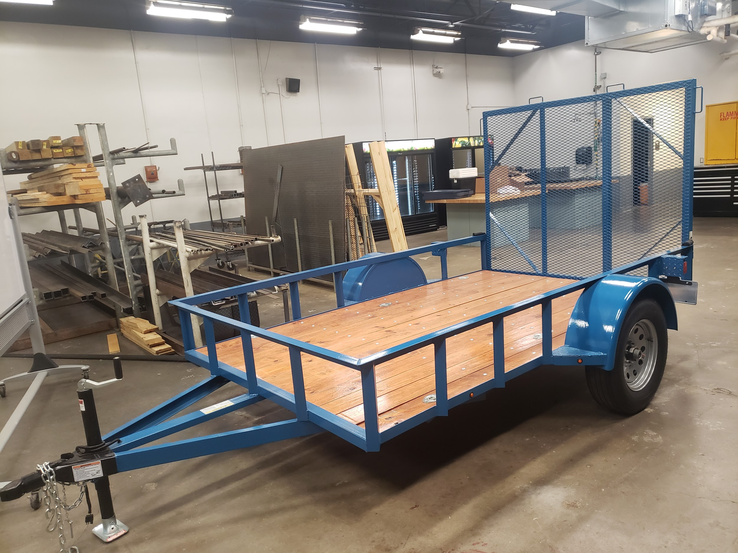
Ag Mechanics
Woodworking
Welding
Project construction for Major and County Shows
Industry Certifications
Welding Contest
Machine/Tool Operation

Slide 8
SDE’s
Speaking Development Events are designed to develop the ability of all FFA members to express themselves on a given subject. Students are encouraged to develop their communication skills and learn to formulate their remarks for presentation in a variety of situations.
Categories
Extemporaneous Public Speaking
Senior Prepared Public Speaking
Junior Prepared Public Speaking
Soil Stewardship Prepared Public Speaking

Slide 9
AET
The FFA Record Keeping System (Record Book) provides students, chapters, teachers, and individuals to record information that pertains to their SAE’s and activities as a student involved in agricultural education courses and as a member of the FFA.
Record Keeping Handbook
The Agricultural Experience Tracker

Slide 10
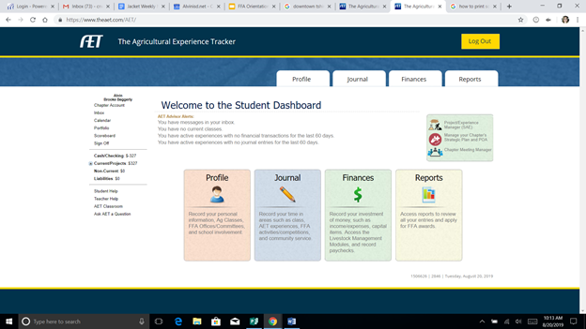
AET
Student Uses:
Online record book system for students SAE(s)
Log hours & money of all activities related to their FFA Experience and SAE
Apply for awards using their record books.
Chapter Uses:
Online log of student participation
Communication
SAE Home Visitation Log
Value Reports

Slide 11
Communication
https://alvinffa.ffanow.org/default.aspx?ID=481
Text 81010 to sign up
You will need to put in the message which of the groups you want to be in.
If you want to be in more than one group you will need to send a separate text for each group.
Cattle reminders type: @cattlei
Goat/Lamb reminders type: @affalag
Poultry reminders type: @poultryi
Rabbit reminders type: @rabbiti
Swine reminders type: @piginfo
Shooting Team: @eghc94
Jr. FFA remind:@alvinjrf NEW***** 3rd-8th Graders & Parents
Sr. FFA remind: @alvinsr NEW***** 9th-12th Graders & Parents

Slide 12
SAE’s
Agricultural Mechanics- Mayo rmayo@alvinisd.net
Cattle- cjennings@alvinisd.net
Lambs/ Goats- cworrel@alvinisd.net
Poultry- Clark cclark@alvinisd.net
Rabbits- Clark cclark@alvinisd.net
Swine- Webb cwebb@alvinisd.net
All Others- AG Classroom Teacher

Slide 13
Community Service
Current Planned Events
“The Day” of Service - September 14th
Haunted Hayride - October 30th
Christmas at the Barn - December 14th
Service Goals for 2019-2020
Donating flower beds
Beach clean-up
Park beautification
Toys for Tots
Canned Food Drive
Gender empowerment talks
Ag tours
Barn buddies

Slide 14
NEW Point System
→ Earn points during the year
→ Incentive Trip in May, 2020
→ More information at the 1st FFA Meeting= August 29th!

Slide 15
Chapter Activities Coming Up
1st FFA & Alumni Meeting -August 29th in the Luke Kennedy Building at Alvin High School 7pm
AET workshop for 7th & 8th graders- August 29th in the Luke Kennedy Library at Alvin High School at 6pm
FFA Fundraiser- August 29th- September 19th
FFA Lock In- September 7th, drop off is at 7pm in the LK Building Pick up is September 8th at 7am.
FFA Greenhand Camp- 1st year FFA Members Saturday September 8th @ 10 am Location: Bobby Verdine Ag Facility
ALVIN ISD “DAY OF SERVICE”- September 14th time and location TBD

Slide 16
The FFA Creed
Presented by:
Cody Kettler
and
Kaylen Patterson

